Slide 1
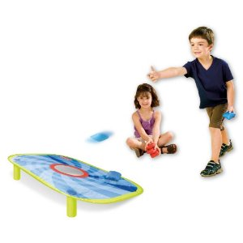
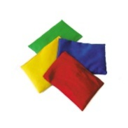
BEANBAG AIMING
EQUIPMENT
Hoops
Beanbags
How many bean bags can you get into the hoops?
2 points if bean bag is inside hoop. 1 point if beanbag is touching the rim.
Various competitions: -
Get as many bean bags in 1 hoop only
Get 1 bean bag in each of the hoops that are set out
Get the same coloured bean bag in the matching hoop
Throw with 1 hand
Throw with 2 hands
These could be run as an individual or as a team
competition

Slide 2
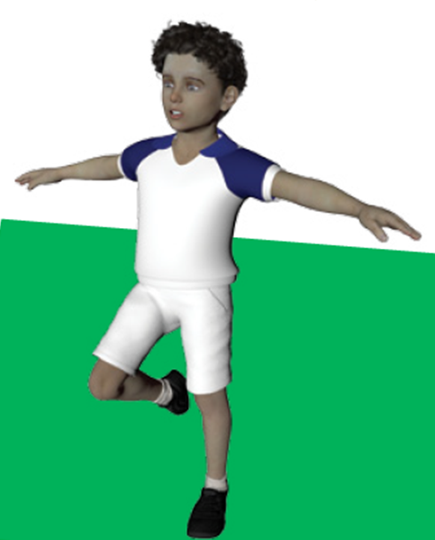
Balance challenge
EQUIPMENT
Stopwatch
How long can you balance on 1 leg?
**1 foot on the ground, other foot next to knee**
Record best time for right foot and left foot balance

Slide 3
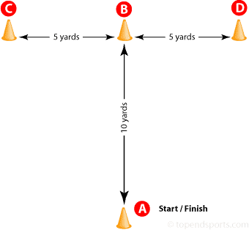
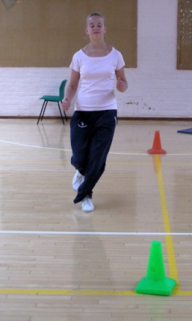
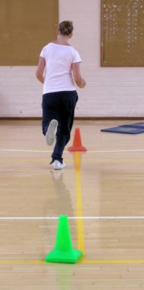
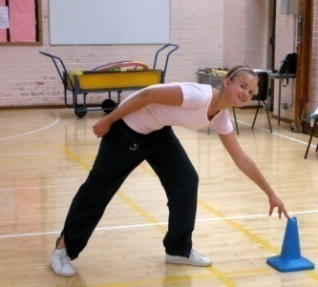
T DRILL TEST
EQUIPMENT
Stopwatch
4 cones
Start at A
Run and touch B
Sidestep and touch C
Sidestep and touch D
Sidestep and touch B
Run back to A
5 steps between A and B
3 steps between B and C
3 steps between B and D

Slide 4
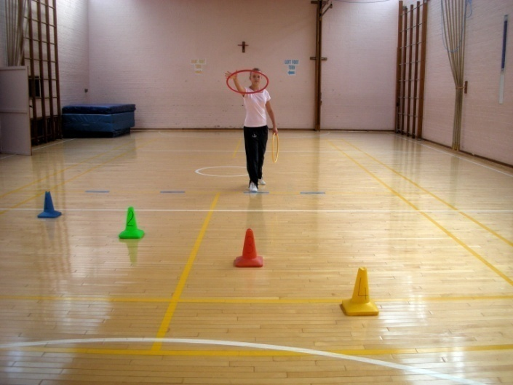
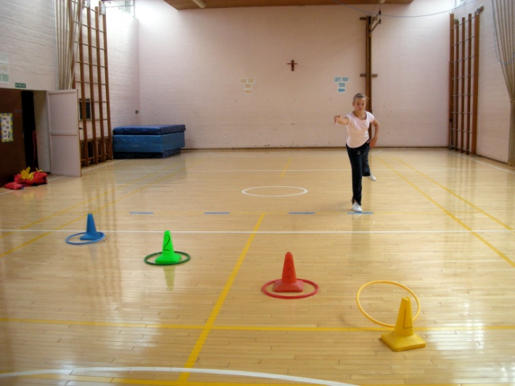
HOOPLA
EQUIPMENT
4 cones
4 hoops
Stand behind the line and throw The nearest cone scores 1 point and the
the hoops over the cones furthest one away scores 4 points.
In order to save space, the cones could be placed one behind the other
4 CONES: -
1 step from start
2 steps from start
3 steps from start
4 steps from start

Slide 5
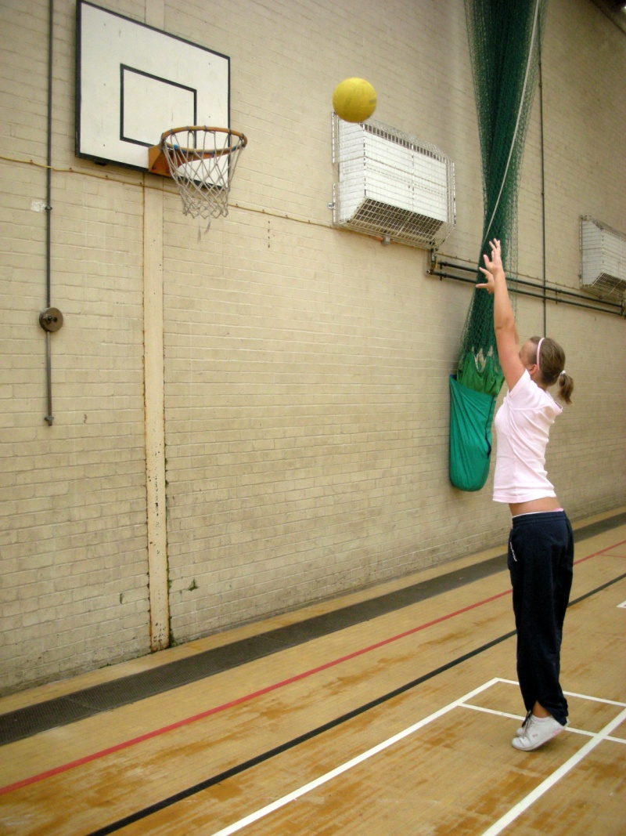
SHOOTING
EQUIPMENT
Netball
Stand behind a line to shoot.
You have 10 attempts
You can use the backboard.

Slide 6
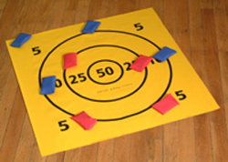
Beanbag darts
EQUIPMENT
Target mat
5 beanbags
Stand behind line with 5 beanbags
Throw one beanbag at a time at the target mat
You can only use each beanbag once
How many points can you score?
**if beanbag covers 2 areas, you score the points that most of the beanbag is covering**
If you don’t have your own mat, chalk it onto the ground.
start
KS1 – start 2 steps away from mat
KS2 – start 3 steps away from mat

Slide 7
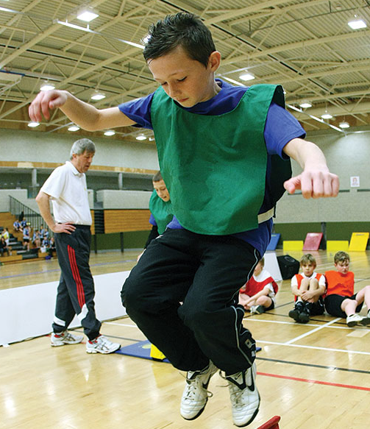
Speed bounce
EQUIPMENT
A line
stopwatch
Stand sideways next to a line
Jump from 2 feet to 2 feet
How many can you do in 30 seconds?

Slide 8


Beanbag on head
EQUIPMENT
Beanbag
2 cones
Start at cone 1 with beanbag on head
Walk/run up to & around cone 2 and back to cone 1
You have scored 1 point
If you drop the beanbag, you must go back to
the previous cone
How many points can you score in 30 seconds?
2
1
6 steps between each cone

Slide 9
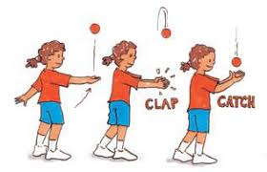
Clap and catch
EQUIPMENT
Beanbag
Throw a beanbag in the air and: -
1st go – clap once
2nd go – clap twice
3rd go – clap 3 times etc
You MUST catch the bean bag after throwing it
How many claps can you do before catching the beanbag?

Slide 10
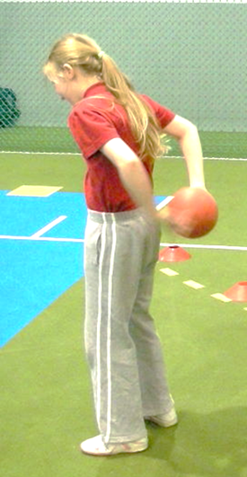
Pass the ball around your body
EQUIPMENT
Large ball – KS2
Smaller ball – KS1
Stand still and pass the ball around your middle
How many times can you do this in 30 seconds?

Slide 11
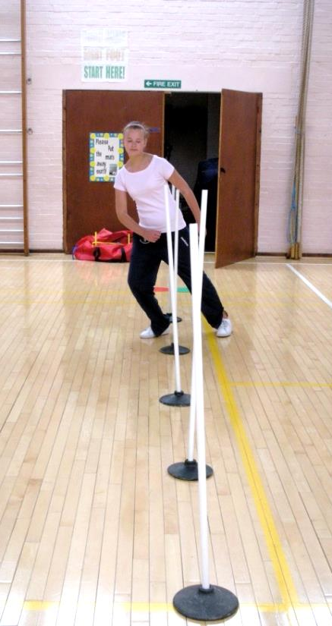
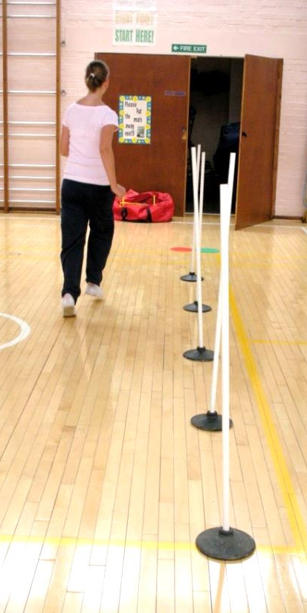
slalom
EQUIPMENT
4 cones
stopwatch
Run in a zigzag pattern between the cones
Then run straight back to the start
You have scored 1 point
How many points can you score in 30 seconds?
2 small steps between each cone

Slide 12
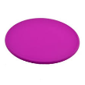
Spot jumping
EQUIPMENT
8 spots
Jump for 2 feet to 2 feet from 1st to last spot
Then run back to start
You have scored 1 point
How many times can you do this in 30 seconds?
Approx 6” or 15cm between each spot

Slide 13
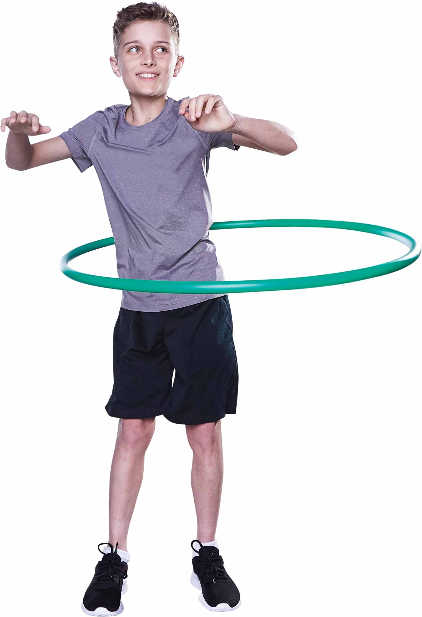
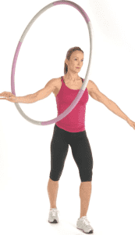
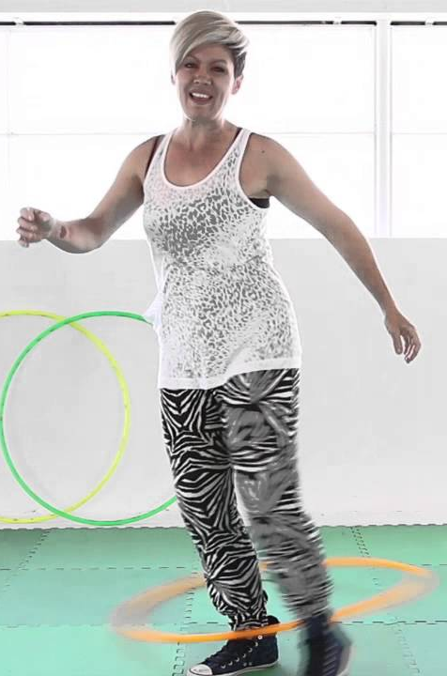
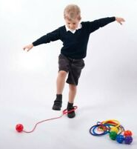
Hula Hooping
EQUIPMENT
Hula hoop
stopwatch
Hula hoop for as long as possible (I suggest
that you set a maximum time limit of 1 minute)
The challenge could be: -
Around the middle
Around 1 arm
Around 2 arms
Or use the foot hula hoop ankle ball

Slide 14
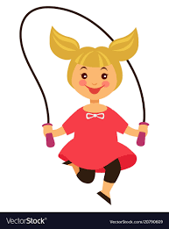
Skipping
EQUIPMENT
Skipping rope
stopwatch
There are skipping games, rhymes & challenges
How many skips can you do in 30 seconds?
Forwards
Backwards
Double pepper (you jump once and turn the rope twice)
Hopping
Hopscotch
Jump from side to side
Jump forwards & backwards

Slide 15
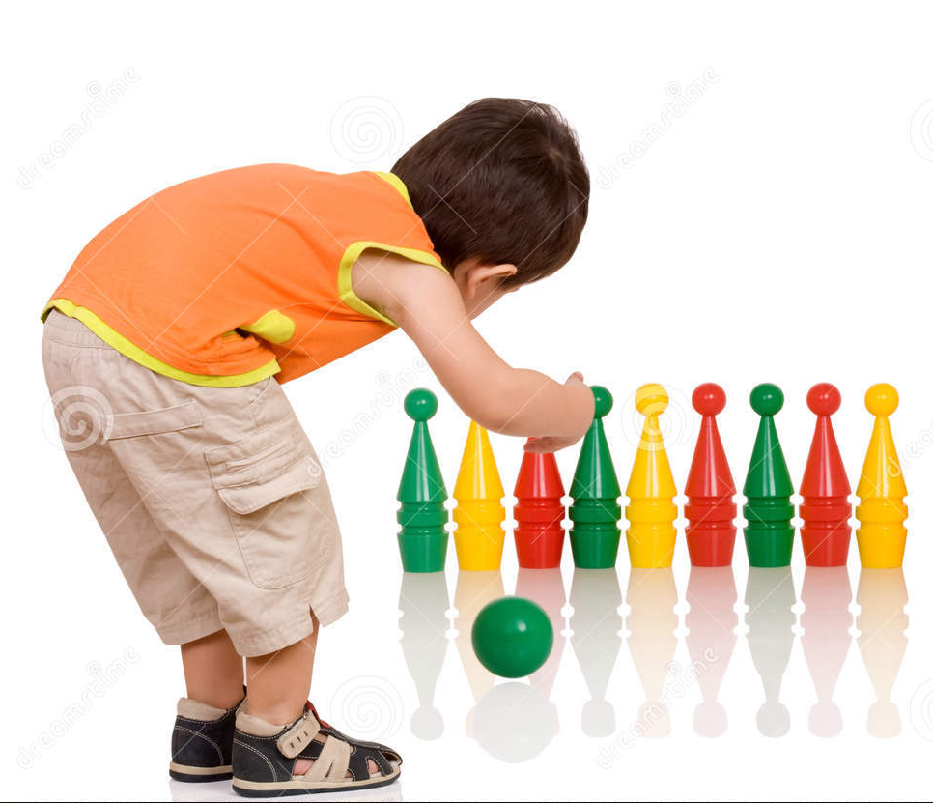
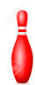
Bowling
EQUIPMENT
Skittles
ball
Roll a ball at the skittles
How many turns does it take before you can knock them all over?
KS1 – place skittles close together
More able/KS2 – spread out the skittles
Children start 5 steps away from skittles

